Slide 1
Market segmentation,
targeting and positioning
4-<number>

Slide 2
What are Markets?
Market: people or institutions with sufficient purchasing power, authority, and willingness to buy.

Slide 3

Requirements of a Markets
Need
Ability
Willingness
Authority
+

Slide 4
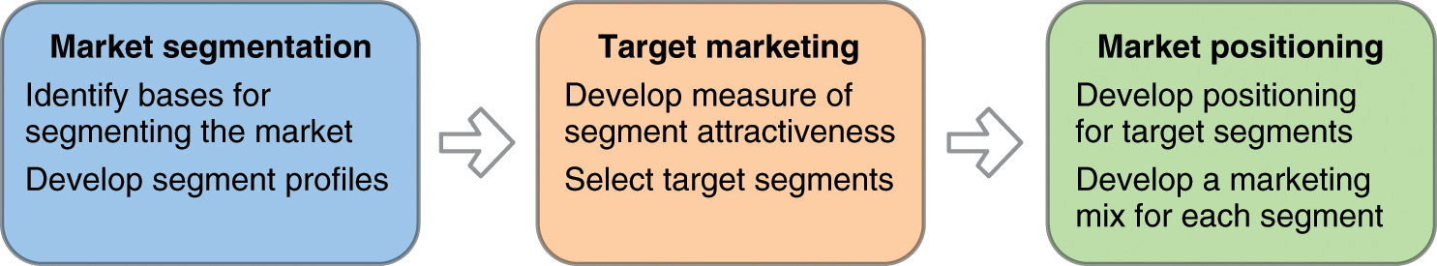
Overview: Segmentation, Targeting & Positioning
Why do this?

Slide 5
Market segmentation
Definition:
This is the process of dividing the total market for a good or service into several smaller, internally similar (or homogeneous) groups.
All members in a group have similar
factors that influence their demand for
the particular product.
4-<number>

Slide 6
Market Segmentation
No segmentation
Mass marketing
Segment
marketing
Niche marketing
Micromarketing
Complete segmentation

Slide 7
Segmenting Consumer Markets
Geographic
Segmentation
World region
Country
City
Climate
Demographic
Segmentation
Age
Gender
Family size
Income
Occupation
Education
Religion
Race
Nationality
Psychographic
Segmentation
Social class
Lifestyle
Personality
Behavioral
segmentation
Occasions
Benefits
User status
Usage rates
Loyalty status
Readiness stage
Attitude toward
product

Slide 8
Bases for segmentation
Geographic — The city size, urban/ suburban/ rural population distribution and climate.
Demographic — The distribution of a
population’s age, sex, income, stage in
family cycle and ethnic background.
Psychographic — Personalities, lifestyles, social class including activities, interests and opinions (AIO).
Behaviour towards products.
  Benefits desired or sought.
  Product usage rate.
4-<number>

Slide 9
Benefits of segmentation
Segmentation enables marketers to:
Identify and satisfy specific benefits sought
by particular groups.
Divide the market into segments by
separating marketing programs.
Select target market.
Action the market segmentation plan.
4-<number>

Slide 10
Market segmentation process
The process involves:
Identifying the needs and wants of customers.
Identifying the different characteristics between market segments.
Estimating the market potential.
4-<number>

Slide 11
Conditions for effective segmentation
A segmentation process must meet 3 conditions:
The characteristics used to categorise customers must be measurable and the data obtainable.
The segment itself must be accessible through existing marketing institutions with a minimum
of cost and waste.
A segment must be large enough to be profitable.
4-<number>

Slide 12
Target market strategies
The target market should be compatible with
an organisation’s goals and image.
The marketing opportunity presented by the segment must match the company’s resources.
The business must generate a profit if it is
to continue its existence.
4-<number>

Slide 13
Market coverage strategies
A. Undifferentiated marketing (Aggregation)
Company
marketing
mix
Market
Company mix 1
Segment 1
B. Differentiated marketing (Single segment)
Company mix 2
Segment 2
Company mix 3
Segment 3
Segment 1
C. Concentrated marketing (Multiple segments)
Company
marketing
mix
Segment 2
Segment 3
4-<number>

Slide 14







Undifferentiated Strategy
Single
Marketing
Mix
Organization
Target Market

Slide 15










Differentiated Strategy
Marketing Mix 1
Marketing Mix 2
Organization
Target Market

Slide 16

Concentrated Strategy
Single
Marketing
Mix
Organization
Target Market

Slide 17
Positioning
Definition:
Customers’ image or perception of a
particular brand or company, relative to their perceptions of others in the same category.
4-<number>

Slide 18
Positioning strategies
Positioning is assessed:
  In relation to a competitor.
  According to a product class or attribute.
  By price and quality.
Positioning can be in various forms, although it always incorporates a statement that identifies, (based on the marketing mix) how a business wants its products or services to be perceived
by the consumer.
4-<number>

Slide 19
Selecting a position
Factors to consider:
Competition — look for a gap or niche.
Customers — seek product attributes.
Company image — what is the current image?
Target market — have the needs of the target market changed? Do we need repositioning?
The marketing mix — does it support the selected position?
4-<number>

Slide 20
THANK YOU
4-<number>

